Slide 1
Active Living
Lori Rhew, MA
Special Projects Coordinator
Community and Clinical Connections for Prevention and Health Branch
NC Division of Public Health

Slide 2
Physical Activity Recommendations
Adults need at least:
Muscle-strengthening activities on 2 or more days a week that work all major muscle groups
(legs, hips, back, abdomen, chest, shoulders and arms)
75 Minutes every week
vigorous-intensity aerobic
jogging or running
150 Minutes
every week
moderate-intensity aerobic activity
OR
PLUS
All adults should avoid inactivity. Some physical activity is better than none, and adults who participate in any amount of physical activity gain some health benefits.
Aerobic activity should be performed in episodes of at least 10 minutes, and preferably, it should be spread throughout the week.
Source: United States Department of Health and Human Services. 2008 Physical Activity Guidelines for Americans. http://www.health.gov/paguidelines/guidelines/. Accessed April 2015.

Slide 3
Physical Activity Reduce the Risk of Chronic Disease
Overweight/Obesity
Heart Disease
Type II Diabetes
Stroke
Colon/Breast Cancer
Hypertension
Source: United States Department of Health and Human Services. Physical Activity Guidelines Advisory Committee Report.. http://www.health.gov/paguidelines/guidelines/. Accessed November 14, 2016.

Slide 4
The risk of dying prematurely declines as people become more active
The most dramatic difference in risk is seen between those who are inactive (30 minutes a week) and those with low levels of activity (90 minutes or 1 hour and 30 minutes a week).
Minutes per Week of Moderate- or Vigorous-Intensity Physical Activity
Source: United States Department of Health and Human Services. 2008 Physical Activity Guidelines for Americans. http://www.health.gov/paguidelines/guidelines/. Accessed November 14, 2016.

Slide 5
Physical Activity
Approximately
30%
Lower risk of early death
Source: U.S. Department of Health and Human Services. Step It Up! The Surgeon General’s Call to Action to Promote Walking and Walkable Communities. Washington, DC: U.S. Department of Health and Human Services, Office of the Surgeon General; 2015.

Slide 6
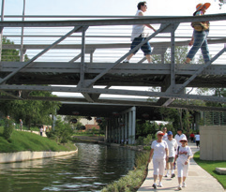
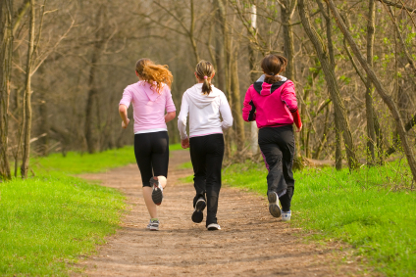
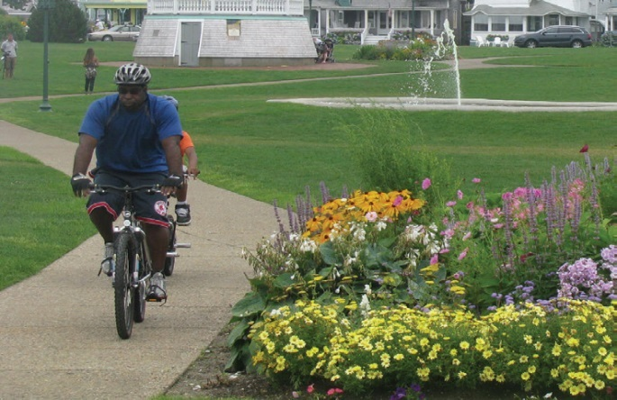
Physical Activity
150 minutes a week = 22 minutes a day

Slide 7
Most Common Types of Activity Reported by Adults Engaged in Physical Activity,
NC BRFSS 2015
*Asked only of those who reported any exercise in the past month. NOTE: There are 69 exercise categories available for this question. The four categories featured in this table had highest frequency of any single category.
Data source: North Carolina Department of Health and Human Services, State Center for Health Statistics, 2015 BRFSS Survey Results, What type of physical activity or exercise did you spend the most time doing during the past month?* http://www.schs.state.nc.us/data/brfss/2015/nc/all/pa_type.html. Accessed October 12, 2016.

Slide 8
Research shows:
Destinations within .5 mile = how far people will walk on average
Public transit = additional 21 minutes a day of walking
More access to green environments (e.g., parks) = more walking
Emerging evidence:
When parks add more signs and conduct outreach activity, the physical activity of park users increases
Source: U.S. Department of Health and Human Services. Step It Up! The Surgeon General’s Call to Action to Promote Walking and Walkable Communities. Washington, DC: U.S. Department of Health and Human Services, Office of the Surgeon General; 2015.

Slide 9
Walking Ads

Slide 10
Walking Ads
Feature tested messaging from Every Body Walk! that emphasizes the opportunity to build stronger relationships and human connections by walking with others
Support the Surgeon General’s Call to Action to Promote Walking and Walkable Communities
Can be co-branded
Available in both English and Spanish
Formats: print, billboard, internet, TV, radio

Slide 11
Walking Ads

Slide 12
2015 Amendment to N.C.G.S. § 115C-524
“Local boards of education may make outdoor property available to the public for recreational purposes subject to any terms and conditions each board deems appropriate, (i) when not otherwise being used for school purposes and (ii) so long as such use is consistent with the proper preservation and care of the outdoor school property. No liability shall attach to any board of education or to any individual board member for personal injury suffered by reason of the use of such school property.”

Slide 13
Open Use Toolkit
Relevant North Carolina Law
Check List for Developing Open Use Policies
Resources
Eat Smart, Move More North Carolina. 2016. Move More: A Toolkit for Promoting Open Use of School Property in North Carolina. Raleigh, North Carolinahttp://www.eatsmartmovemorenc.com/News/Texts/Move_More A_Toolkit_for_Promoting_Open_Use_of_School_Property_in_North_Carolina-Final.pdf

Slide 14
North Carolina’s Plan to Address Obesity: Healthy Weight and Healthy Communities 2013-2020
Settings
Health care
Child care
Schools
Colleges and universities
Work sites
Faith-based organizations and other community organizations
Local government
Food and beverage industry
EatSmartMoveMoreNC.com

Slide 15
Making physical activity the easy choice
www.pedbikeimages.org/LauraSandt

Slide 16
Questions?

