Slide 1
Stroke
Awareness
Matters
Notes:
Stroke Awareness Matters or SAM

Slide 2
Welcome and Introduction
Mission:
  Providing stroke education to school aged children across eastern North Carolina.
Vision:
  Increase awareness and response to stroke.
  Decrease stroke mortality in eastern North Carolina.
  Provide education to aid in reduction of modifiable risk factors for stroke.
Notes:
For educators/standard course of study matching

Slide 3
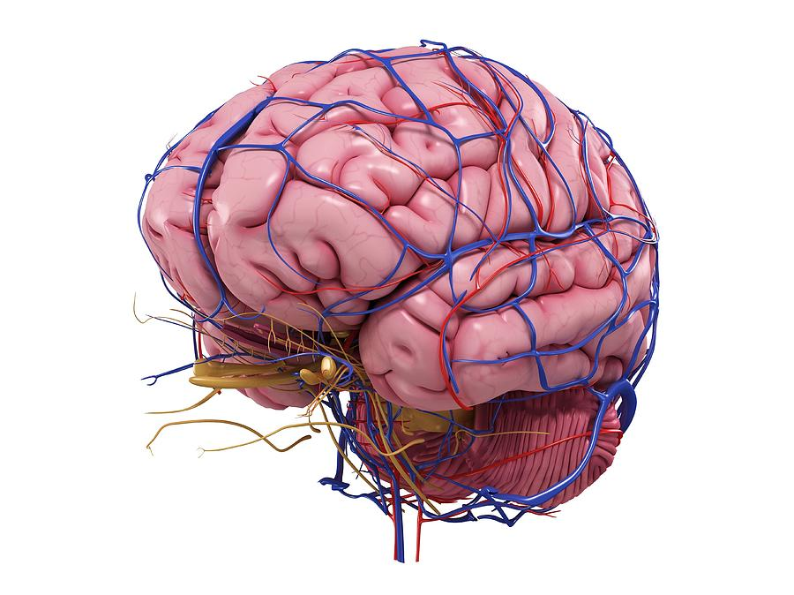
Welcome and Introduction
What is a stroke?
A Brain Attack!
Notes:
Welcome & Introduction of trainer
Today we will be talking about stroke.
Does anyone know what a stroke is?
A stroke is when something goes wrong inside your brain.
What does our brain do for our body?
Everything! It is in charge of our whole body. It helps us think, talk, move, and jump. Our brain works like a remote for the tv, a hard drive for the computer, or the engine of a car.

Slide 4
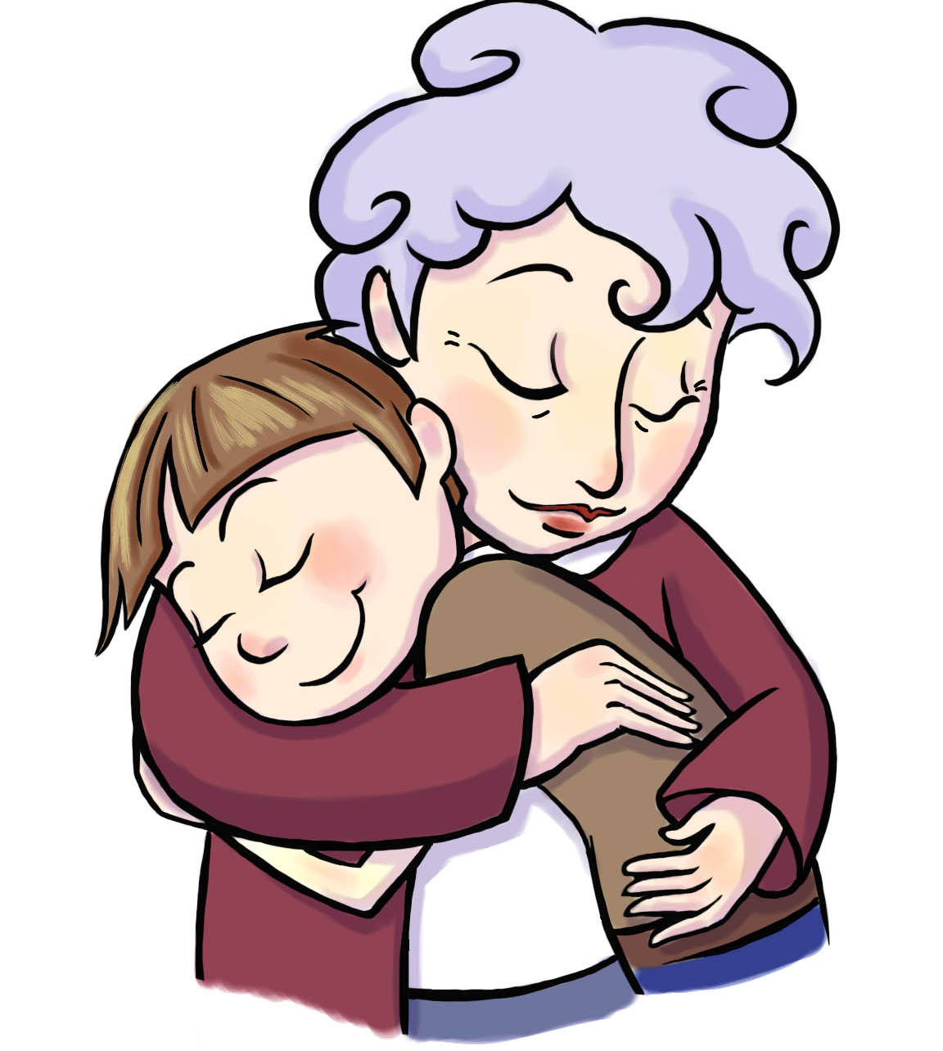
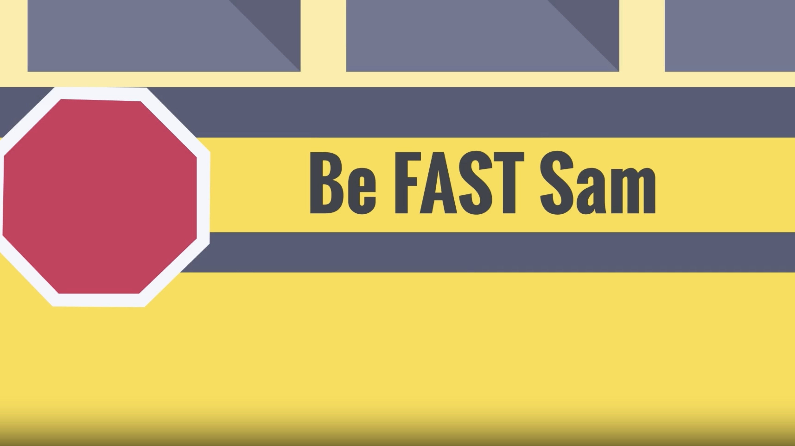
Let’s watch a movie together…
Notes:
Introduction:
How many of you have a grandma that you see regularly?
We are going to watch a video about a boy about your age and his grandma. The video will help us understand a little more about stroke.
NOTE –
Show video if downloaded from https://www.startwithyourheart.com/stroke-awareness-matters/, or click video thumbnail to stream from browser
(https://www.startwithyourheart.com/wp-content/themes/swyh2019/assets/downloads/Coverdell/Be-FAST-Sam.mp4)
After the video discussion.
Examples of discussion questions:
What should you do if you think someone is having a stroke?
What might you see if someone is having a stroke?
What might you hear if someone is having a stroke?

Slide 5

Let’s Get Loud! Cheer for SAM
SAM
Notes:
Cheer to bring out our friend SAM.
Bee mascot costume comes out to interact with the students.

Slide 6
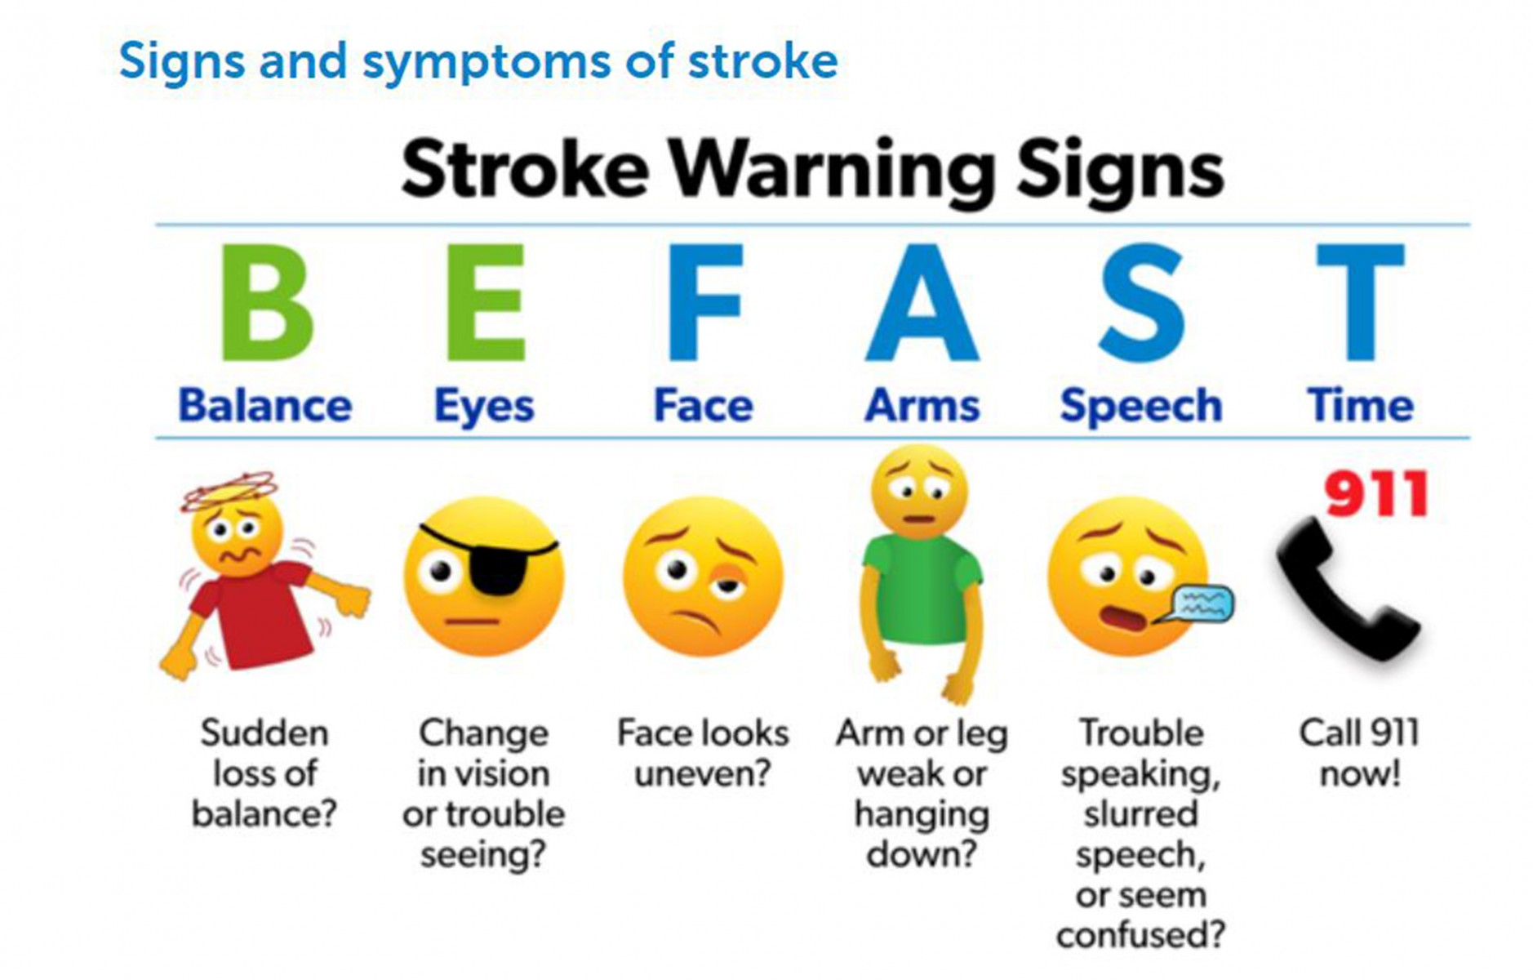
Signs and Symptoms of Stroke
Notes:
SAM to act out signs as you go through them.
Also relate back to the video.
For example: did you notice anything about grandma’s eyes in the video?

Slide 7
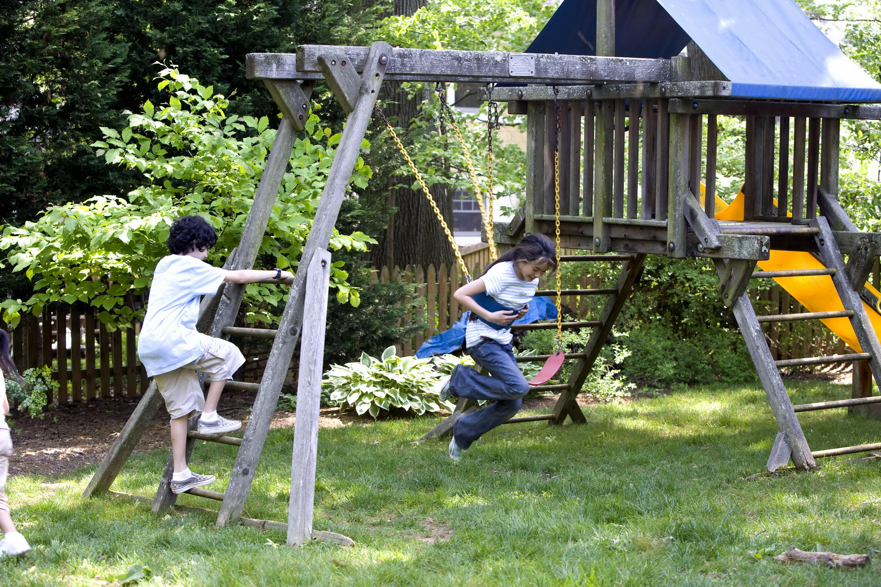
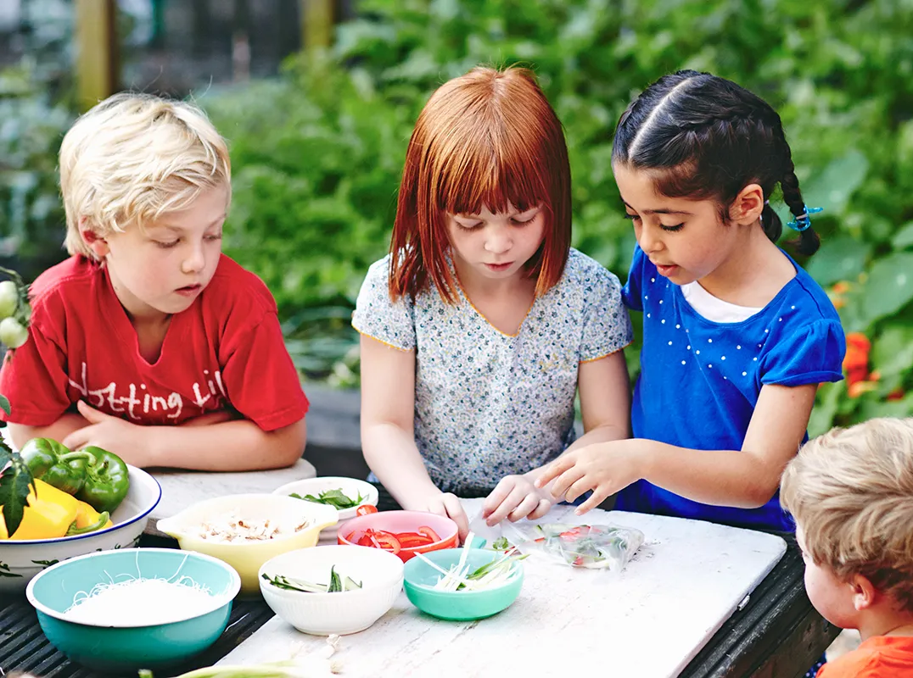
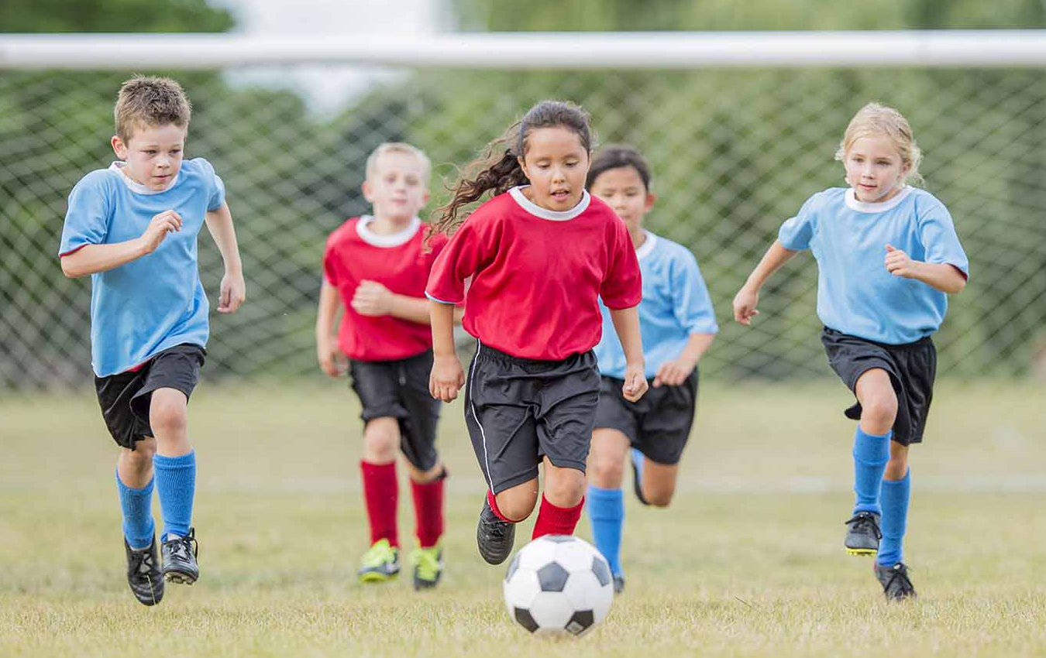
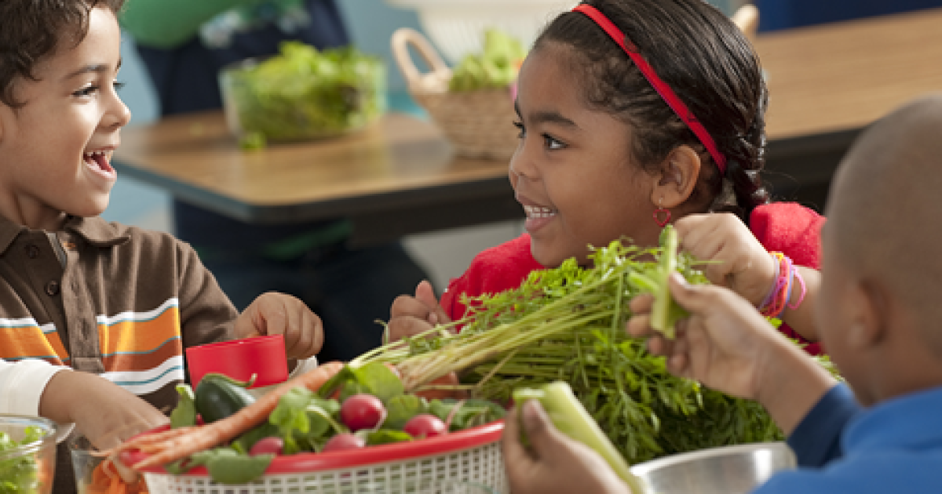
How to Avoid A Stroke
Eat Healthy
Be Active
Don’t Smoke or Vape
Notes:
There are three things you can do right now to help prevent a stroke when you get older.

Slide 8
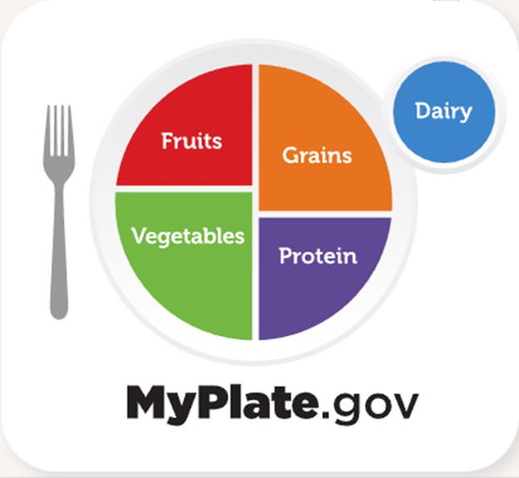
Eat Healthy
Make Half Your Plate Fruits and Vegetables
What are some examples of healthy fruits and vegetables?
Notes:
Ask students for examples of healthy fruits and vegetables.

Slide 9
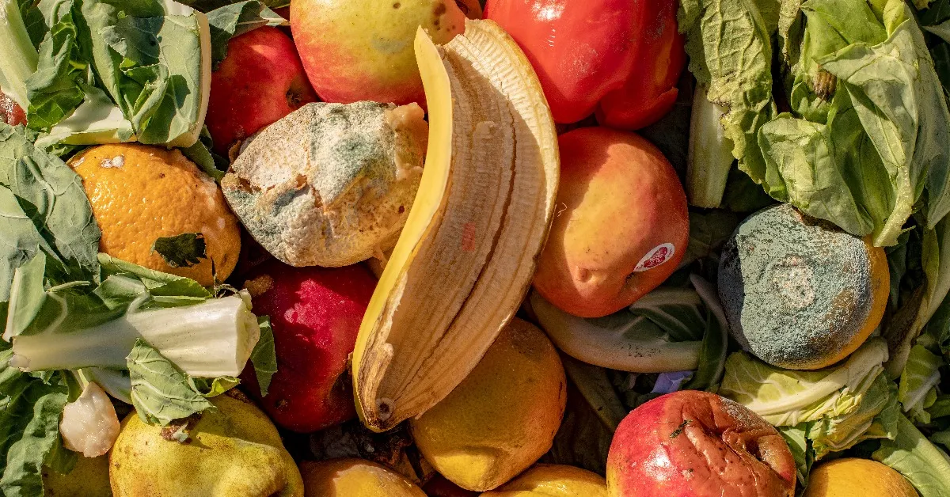
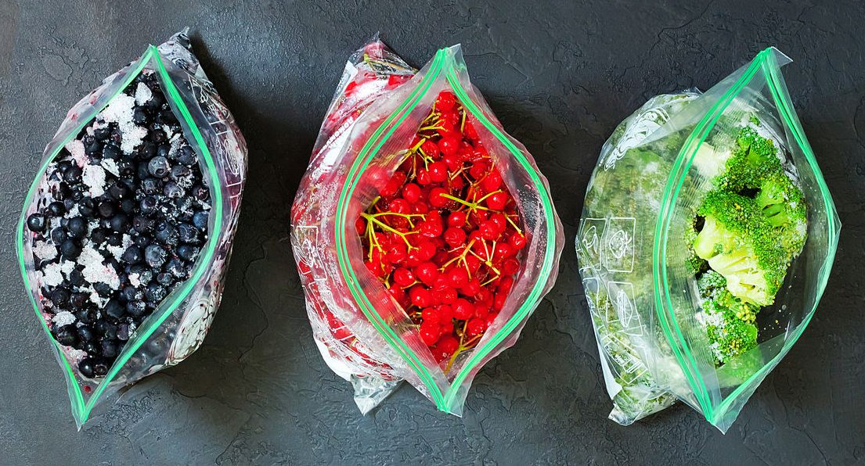
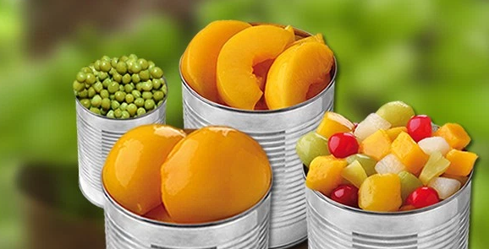
Eat Healthy
Make Half Your Plate Fruits and Vegetables
1.
3.
2.
100% Real Juice
Low Sodium or No Salt Added
Notes:
Fruits and Vegetables
Fresh Fruits/Vegetables
Get only what you can use before it spoils
Canned Fruits/Vegetables
Choose fruits canned in 100% fruit juice
Choose vegetables canned with “low-sodium” or “no salt added”
Frozen Fruits/Vegetables
Stock up the freezer - these items are as good for you as fresh and may cost less. Freeze them yourself or buy them pre-packaged frozen. Look for the same labels as canned foods (low sodium, no sugar added, no other ingredients on the label other than the fruit or vegetable)

Slide 10

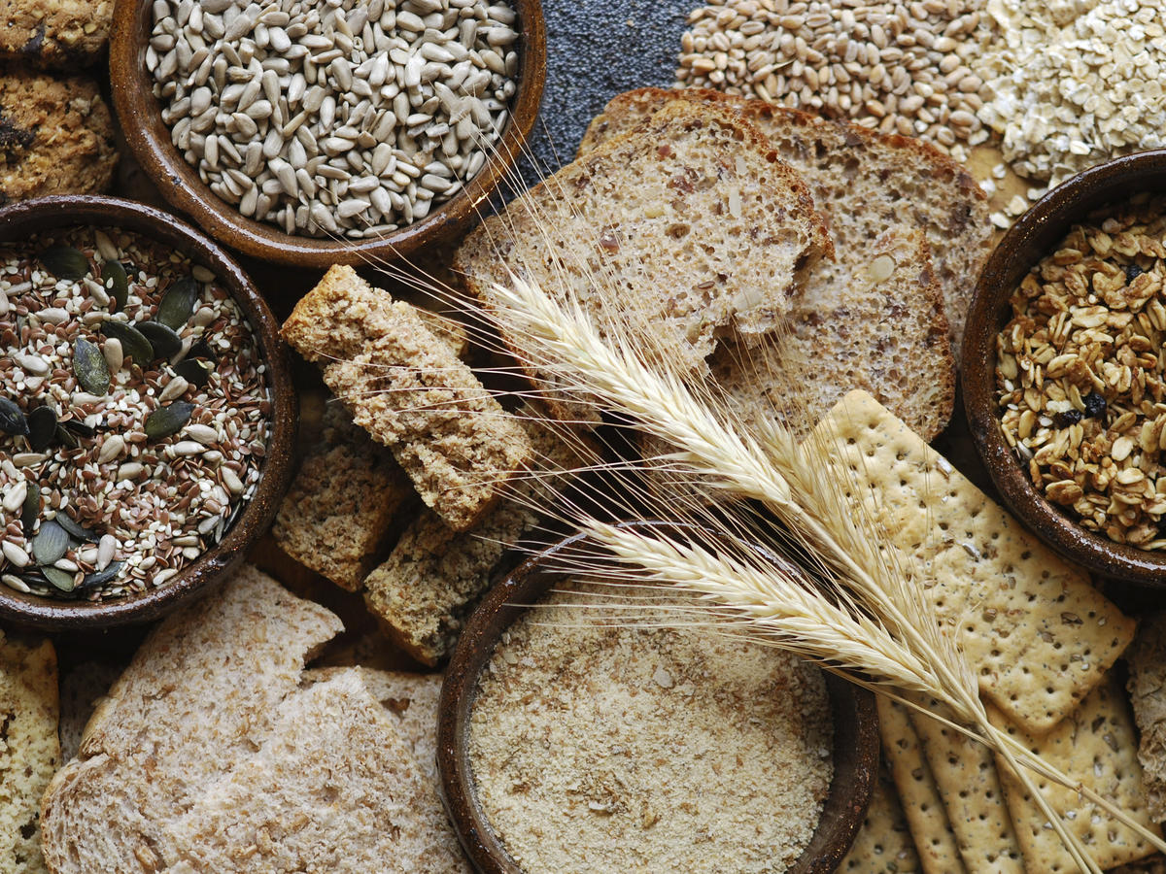
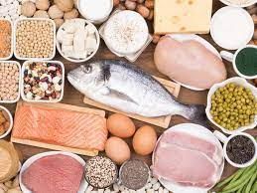
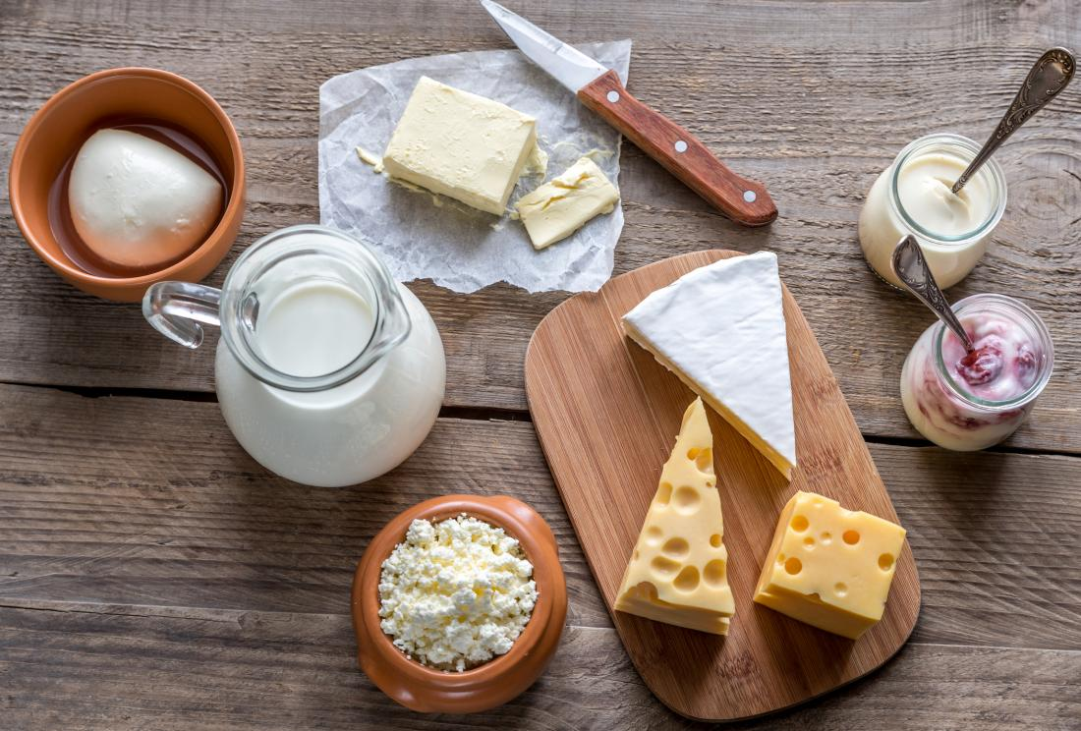
Eat Healthy
Make Half Your Grains Whole
Lean Proteins
Low Fat Dairy
Notes:
Ask students for examples in each food group as you discuss?
Grains: What are some examples of whole grain foods?
(Bread, Cereal, Pasta and Rice)
Protein: What are some examples of lean protein foods?
beans, peas and lentils as a low cost protein
lean meat like chicken, fish and turkey
Dairy: What are some examples of low fat dairy foods?
Milk, yogurt, cheese, butter
Choose low-fat yogurt and add flavor by mixing in fruits and granola (3 of the food groups in one snack!)

Slide 11
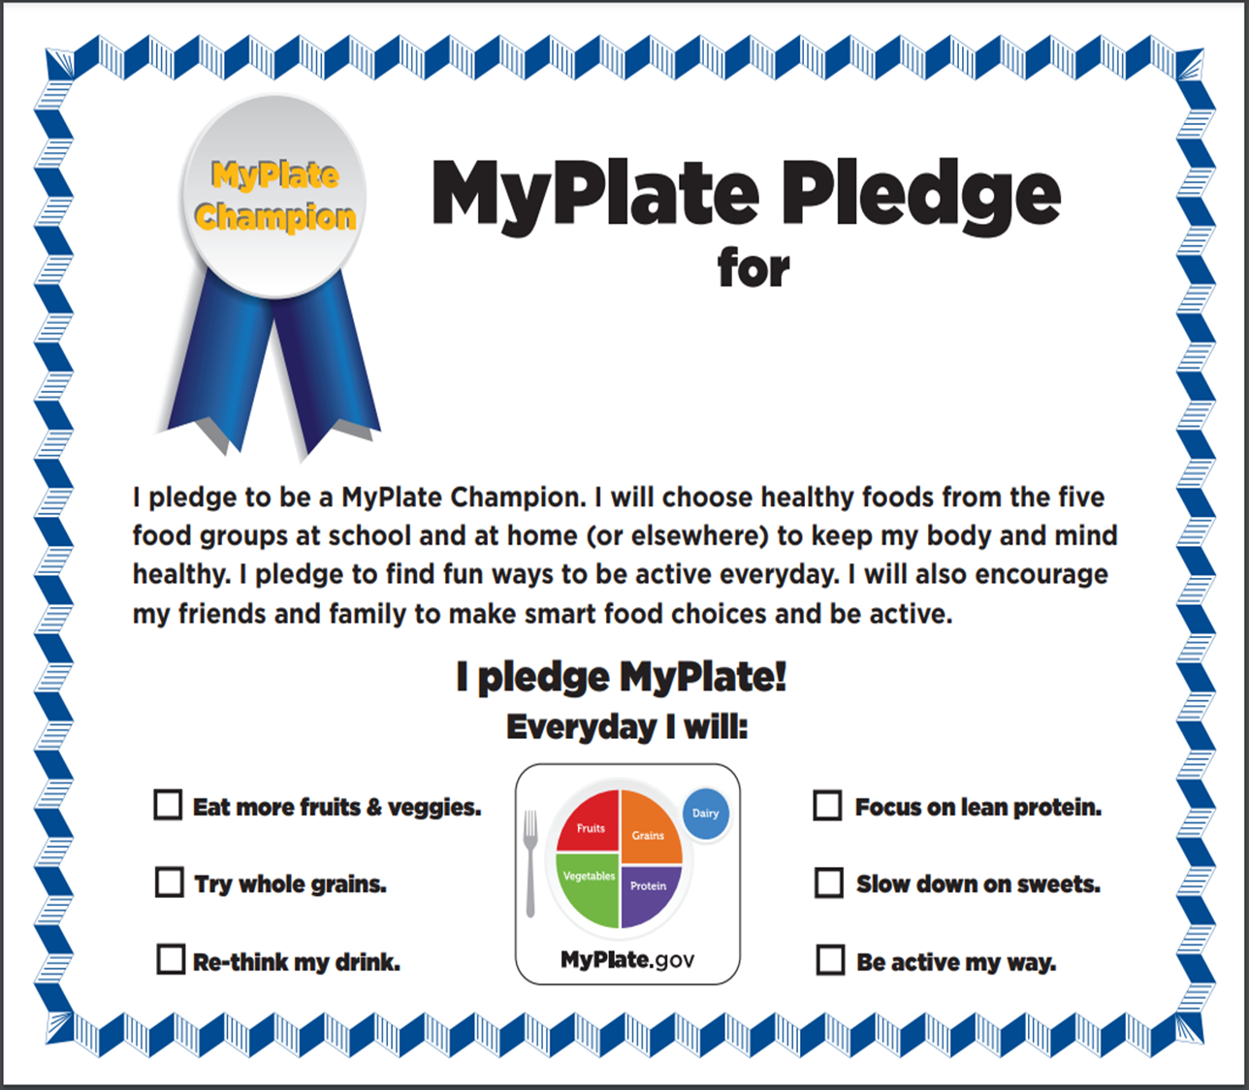
Notes:
Will be included in the teacher kits or may be downloaded at https://myplate-prod.azureedge.us/sites/default/files/2020-12/MyPlatePledgeCertificate_0.pdf.

Slide 12
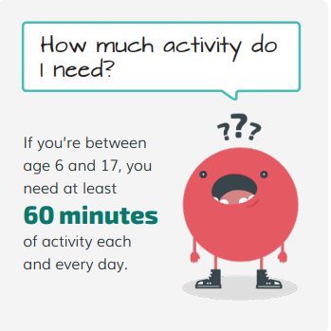
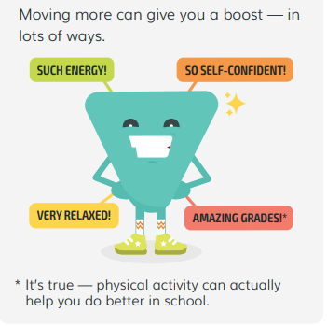
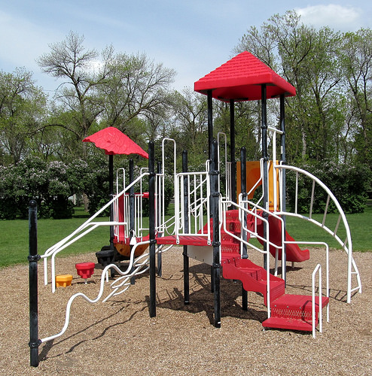
Be
Active
Notes:
Discuss information on images.
Especially getting across the point that being active also helps give you a boost.

Slide 13

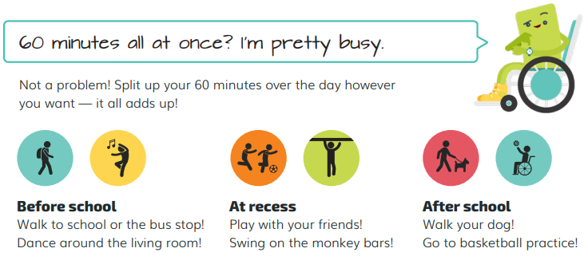
Notes:
Main point – activity can mean anything that gets your body moving. Even everyday activities like cleaning your room, walking your dog, dancing around the living room.

Slide 14
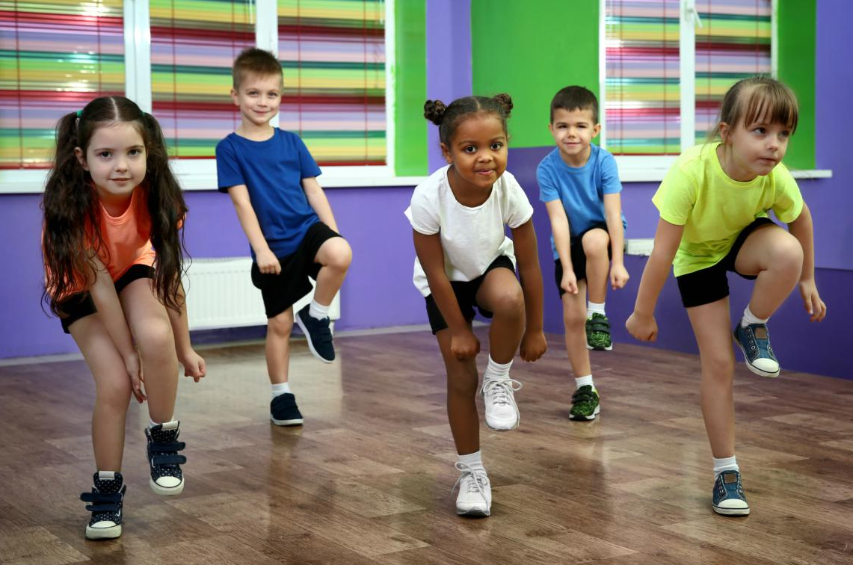

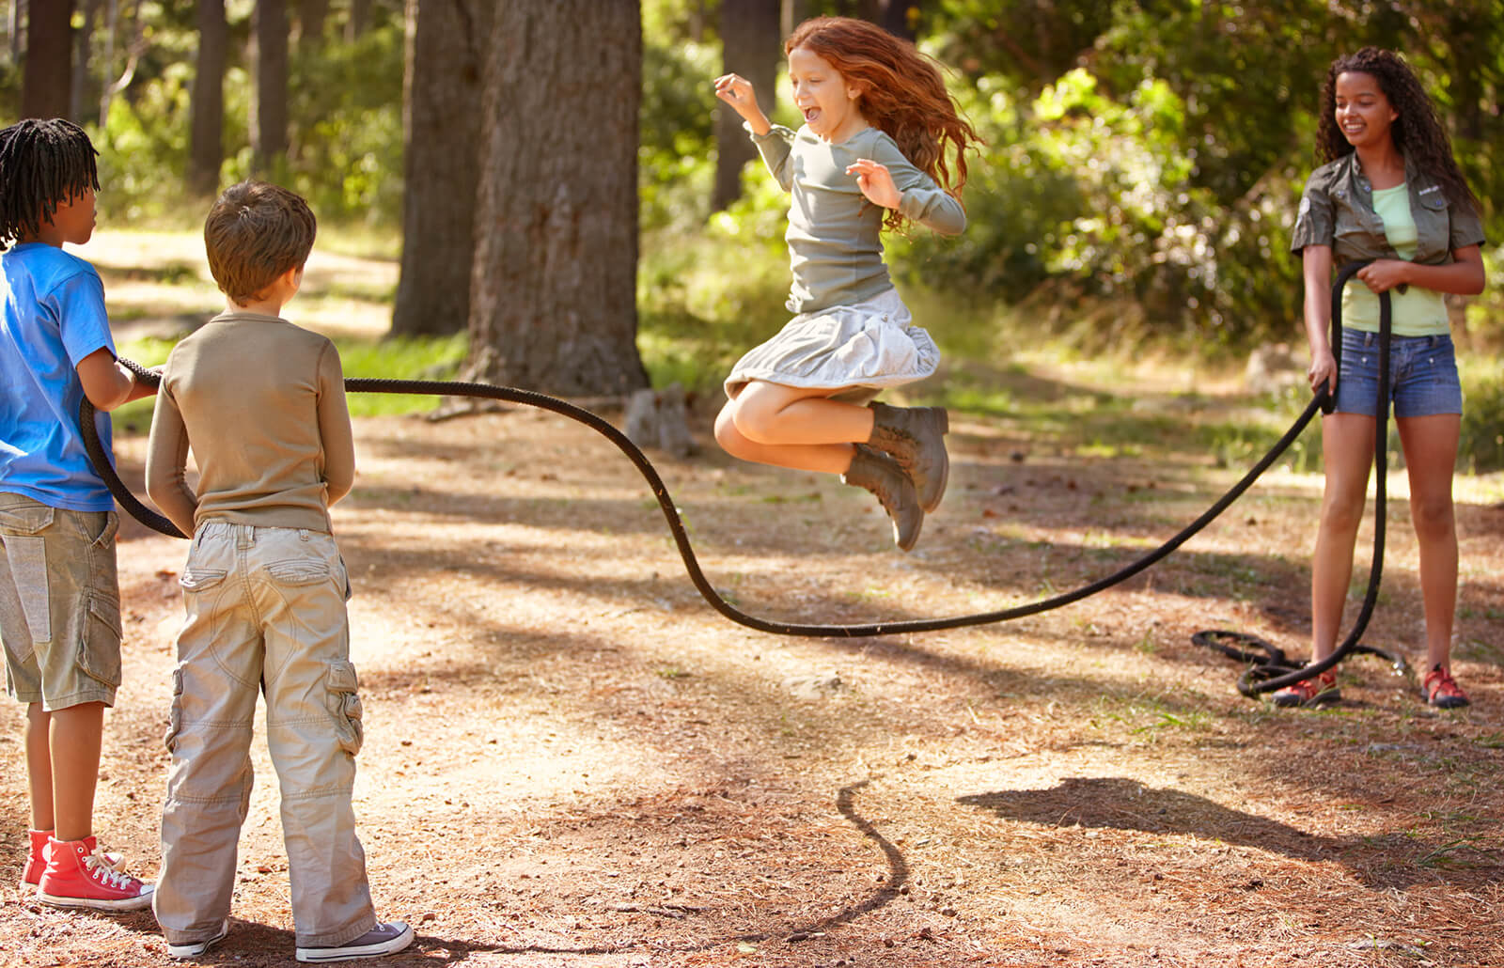
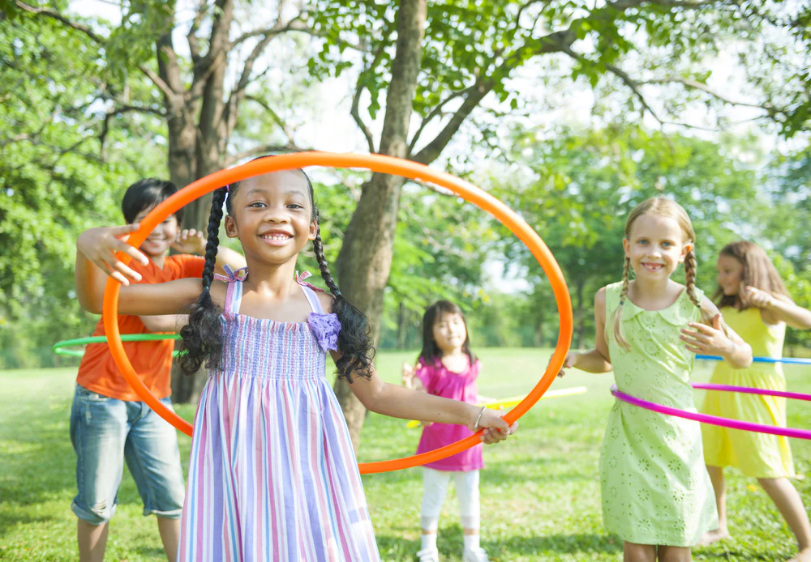

What Activity Do You Like to Do?
Notes:
Have SAM do an activity and include students with a foot stomp/drum roll.

Slide 15
Don’t Smoke or Vape
Notes:
Introduction Slide

Slide 16
What happens to people who smoke?
They cough a lot.
It’s hard for them to breathe. Especially when they are doing active things.
Their skin is dry and crackly.
Their breath and clothes smell bad.
Notes:
Ask students before you animate the answers on the slide: What happens to people who smoke or vape?

Slide 17
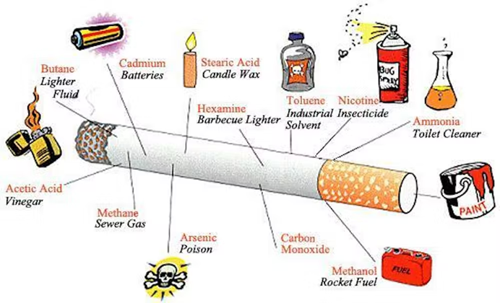
And why do those things happen?
Cigarettes and cigarette smoke can cause damage to almost every organ in your body: lungs, heart, brain, blood stream, skin, etc.
Notes:
Some of those chemicals include:
Tar (What is tar used for?)
Cadmium (Cadmium is found in batteries)
Arsenic (is poison)
Name a chemical and ask students if they’ve heard of it before? Where?

Slide 18

Is Vaping Safer Than Smoking Cigarettes?

Slide 19

E-Cigarettes: Sometimes Called Vaping
What is Vaping?
Notes:
Electronic cigarettes (e-cigarettes) are battery-powered devices that deliver nicotine, flavorings, and other ingredients to the user.
Using e-cigarettes is sometimes called “vaping.”
E-cigarettes do not create harmless “water vapor” – they create an aerosol that can contain harmful chemicals.

Slide 20
Smoking and Vaping: The Facts
WRONG: Nicotine, other cancer-causing chemicals, ultrafine particles, the flavorings can cause lung disease, heavy metals such as nickel, tin, and lead.
E-Cigarettes don’t contain harmful chemicals like regular cigarettes.
E-Cigarettes aren’t as addictive as regular cigarettes.
WRONG: Nicotine is found in e-cigarettes. And what do we know about nicotine?
Notes:
You may hear people say… (read the “myths” in blue) and then reveal the actual answer.
What do we know about Nicotine? (in case students don’t know)
Exposure to nicotine at a young age can:
» Harm brain development, which continues until about age 25.
» Impact learning, memory, and attention.
» Increase risk for future addiction to other drugs.
Nicotine is more addictive than cocaine and heroin.

Slide 21
Let’s Review
Name a sign or symptom of a stroke:
B
E
F
A
S
T
A
L
A
N
C
E
Y
E
S
A
C
E
R
M
S
P
E
E
C
H
I
M
E

Slide 22

How Many Minutes of Activity
Should I Do Each Day?
Notes:
Review with SAM the Bee mascot.

Slide 23
Name a Food
on My Plate

Slide 24
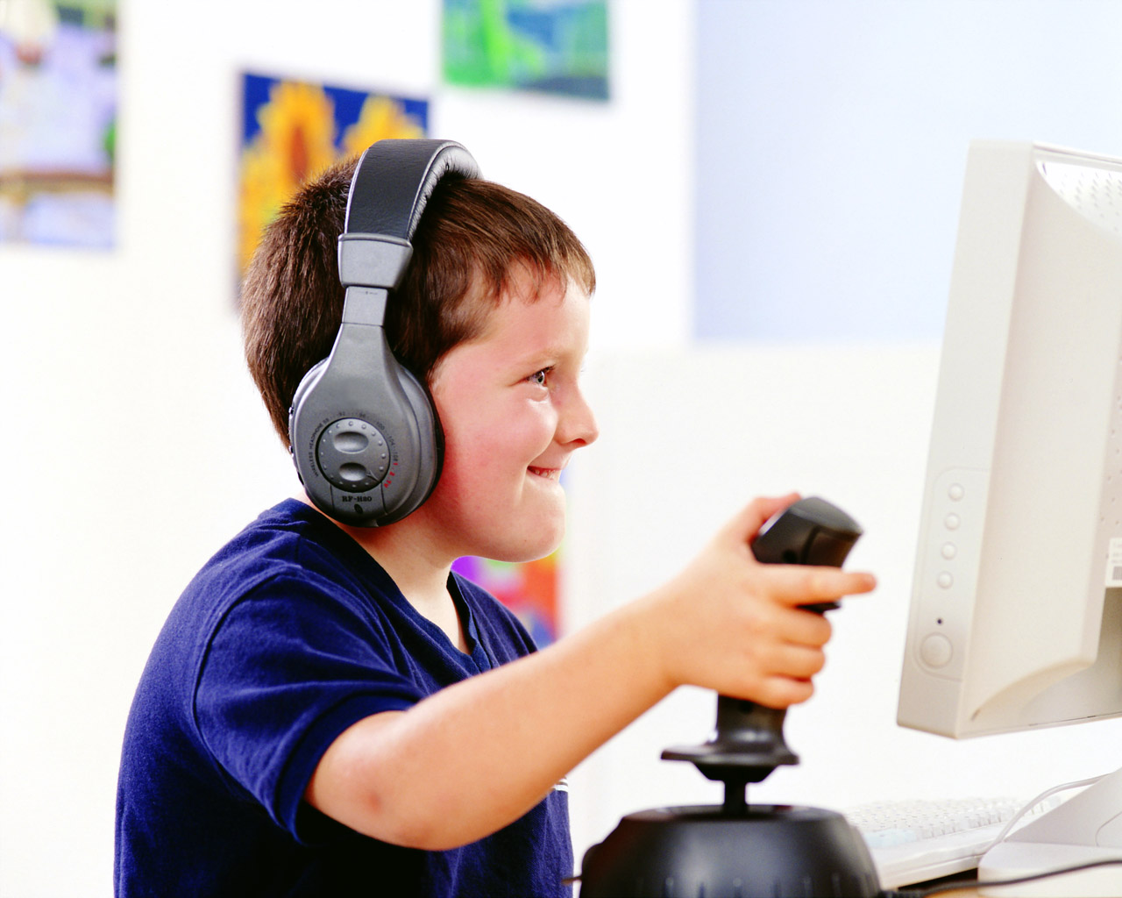
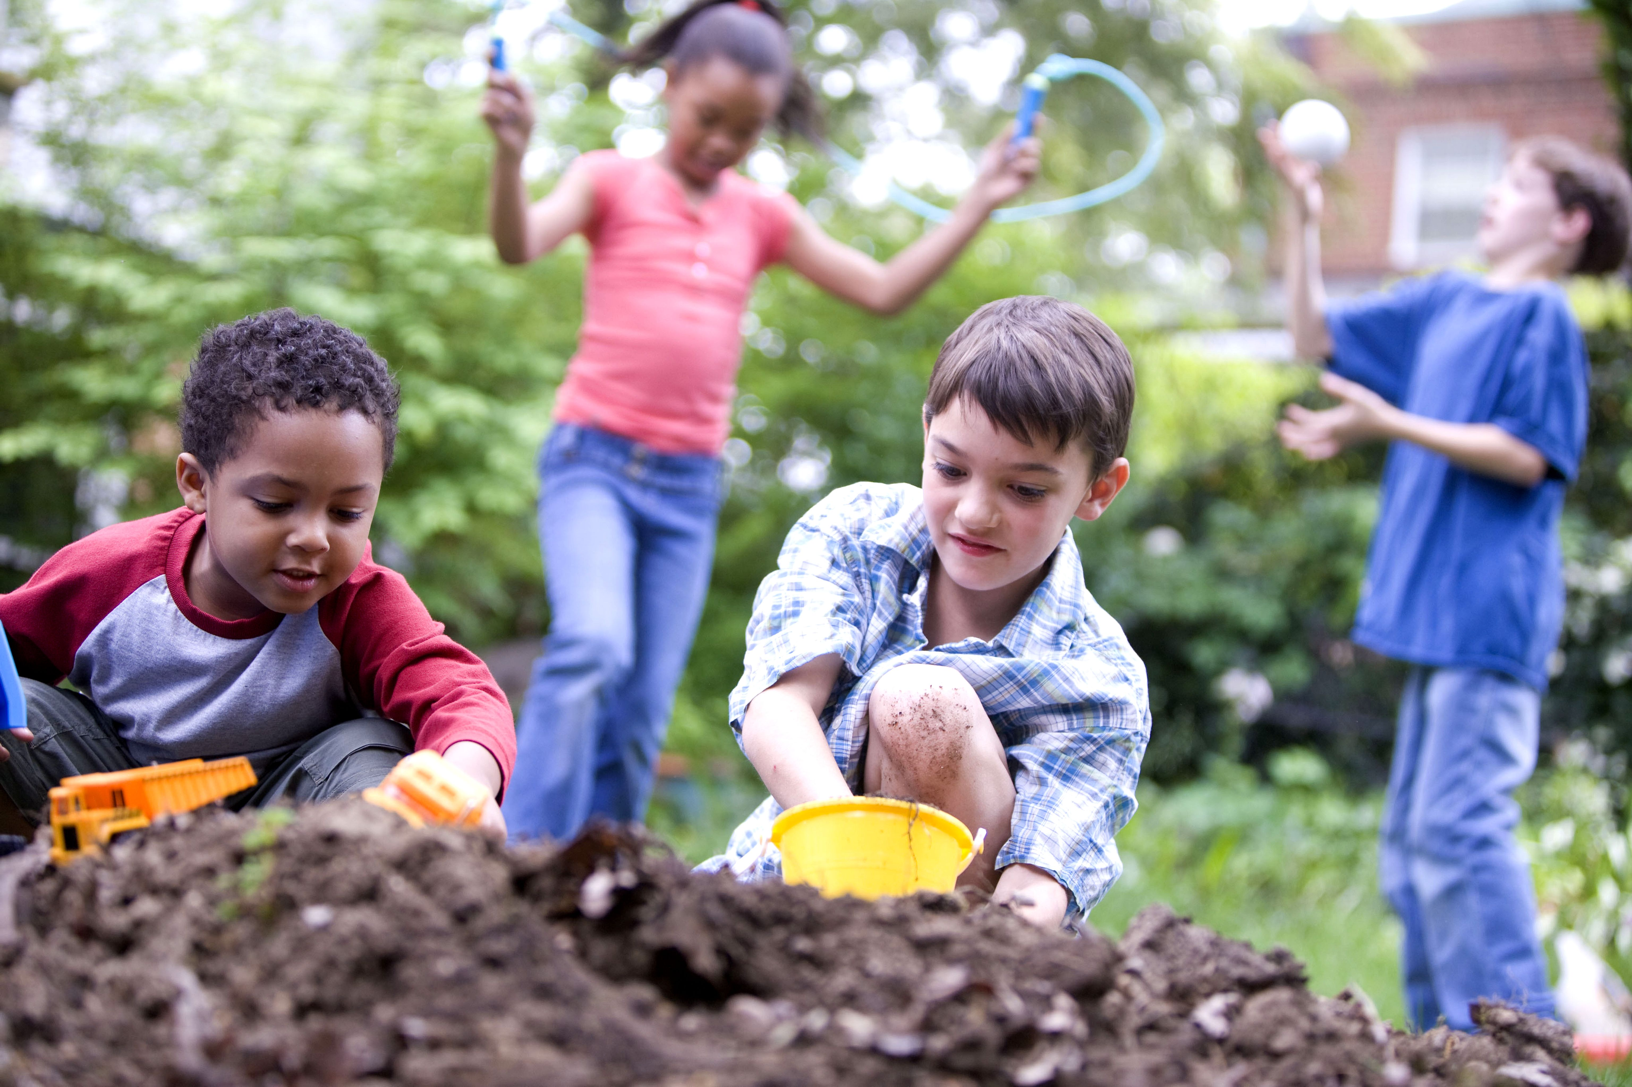
Which is Healthier?

Slide 25
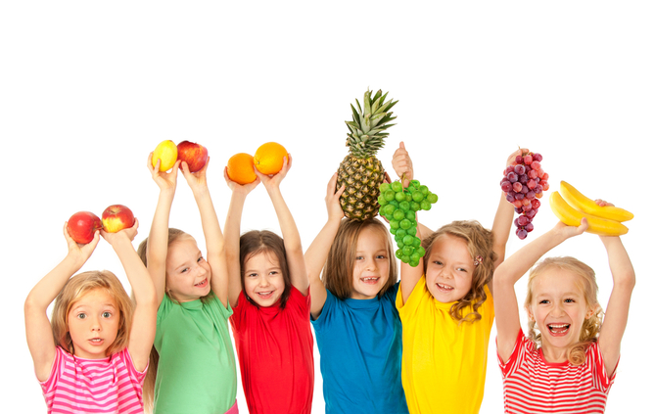
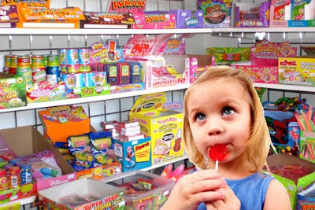
Which is Healthier?

Slide 26
The End
Signs and Symptoms of a Stroke
Notes:
One more time to help students remember. Don’t need to go through them just display slide for your closing.

Slide 27

References
  My Plate: https://www.myplate.gov/
  Healthy Habits: https://health.gov/
  Vaping Website:
  https://www.cdc.gov/tobacco/basic_information/e-cigarettes/pdfs/OSH-E-Cigarettes-and-Youth-What-Educators-and-Coaches-Need-to-Know-508.pdf
  Exercise Website: https://www.cdc.gov/physicalactivity/basics/adults/health-benefits-of-physical-activity-for-children.html
Notes:
Grandpa’s Crooked Smile book- put in the teacher kits to give out in the classroom. SAM certificate to put in teacher toolkits to provide to students (picture of SAM on it)

